Slide 1
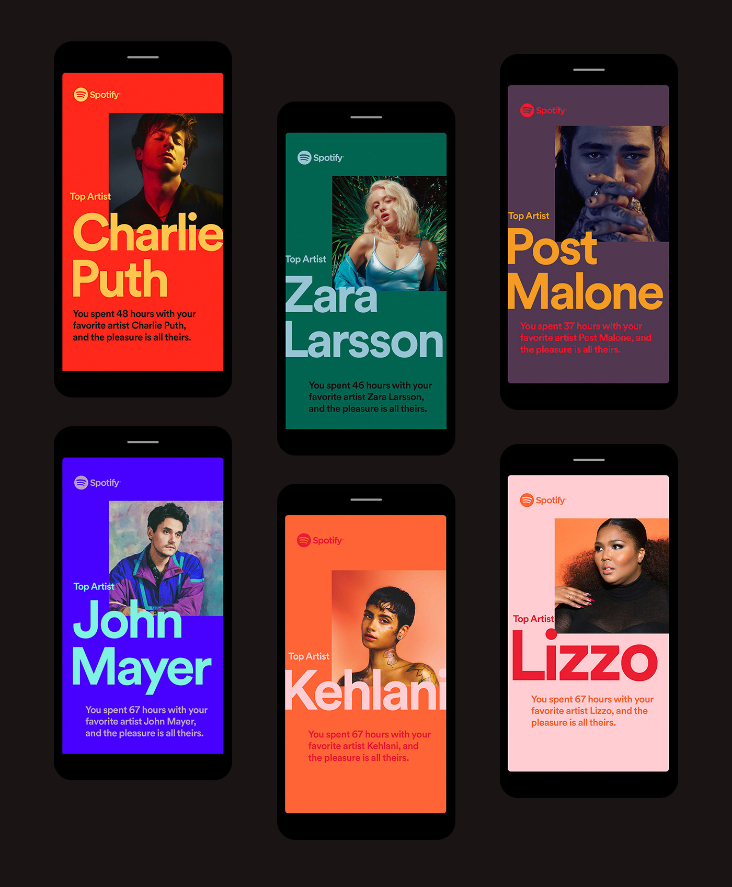
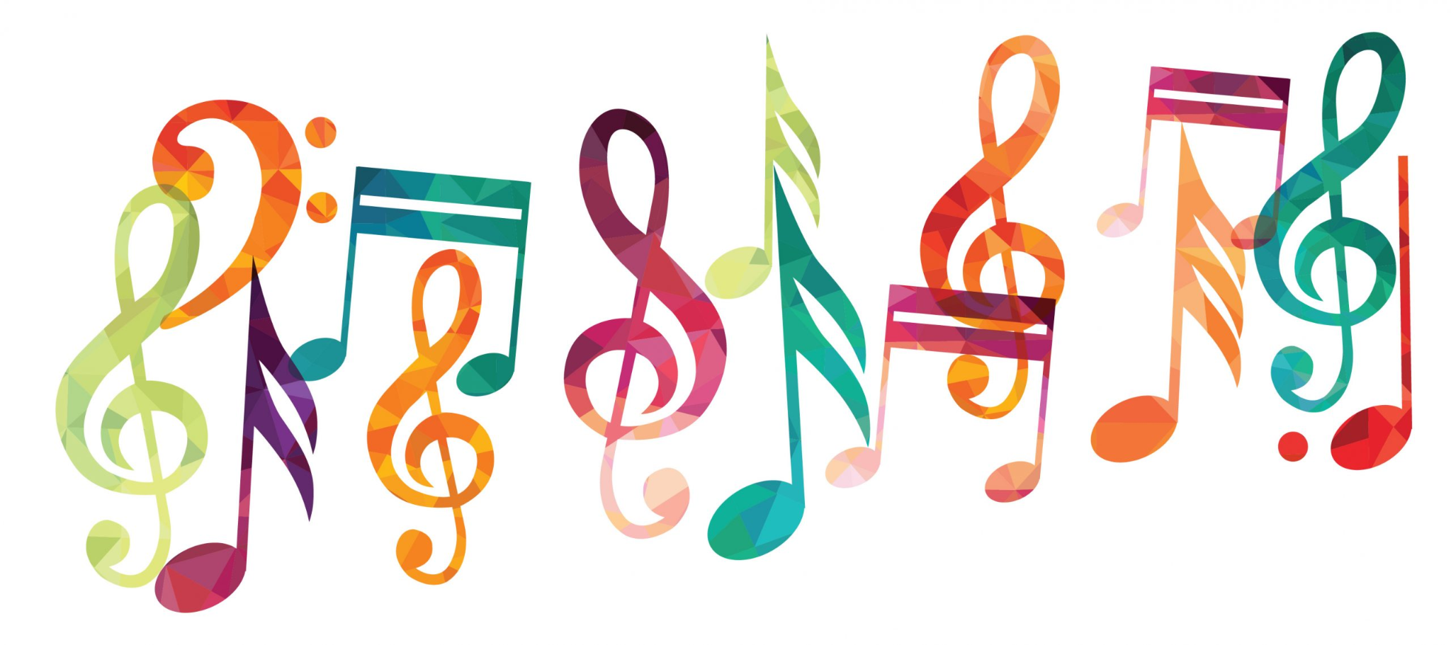
Spotify Data Analysis
LYDIA DETERDING
JULIE BAKER
BRECKIN SHOEMAKER

Slide 2

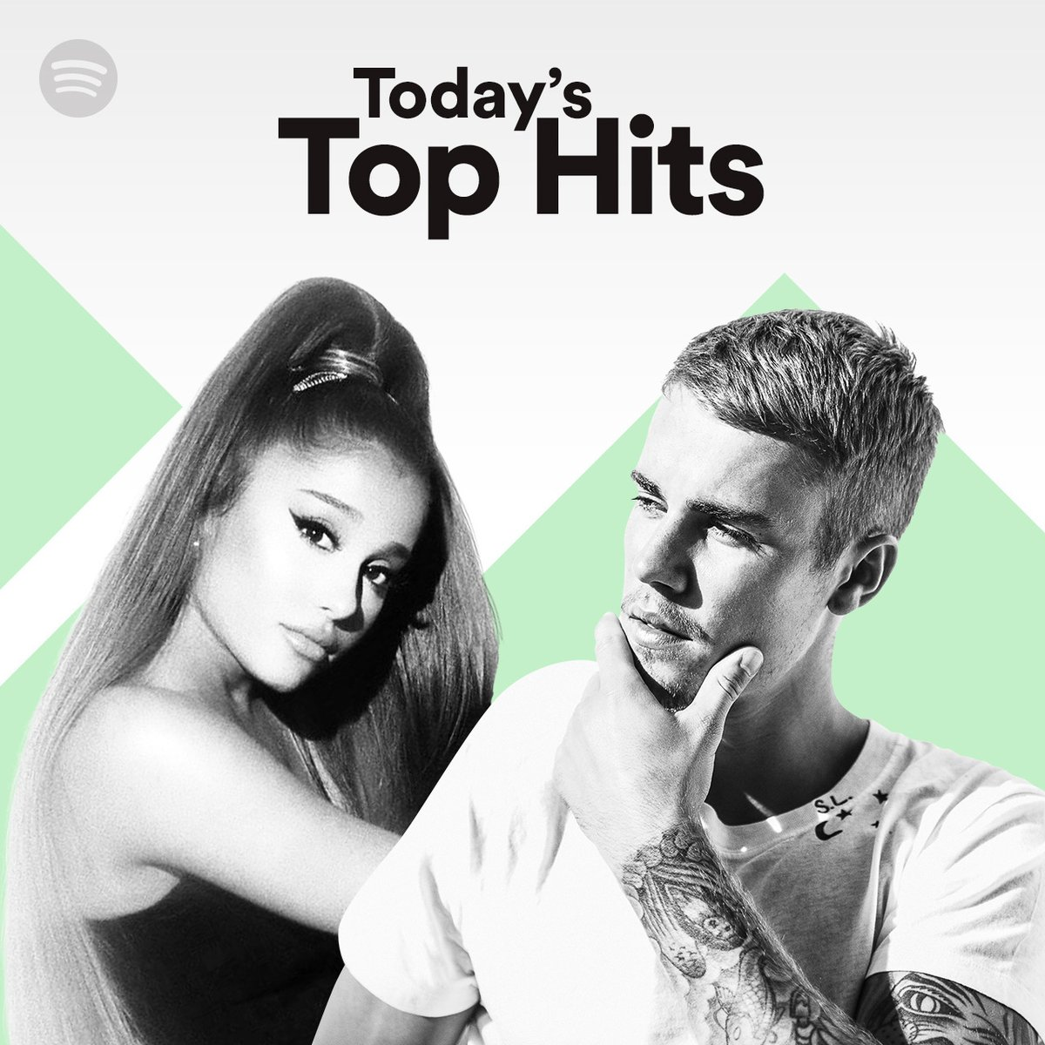


The Main Question
Is there a correlation between certain features of a song and the resulting popularity of the song?
Resource: https://developer.spotify.com/documentation/web-api/reference/#endpoint-get-audio-features

Slide 3
The questions asked:
What audio feature has the strongest relationship with average popularity?
How do the audio features correlate with one another?
Are explicit songs more or less popular than non-explicit songs?
What genre of songs, on average, are more popular?
Does the number of songs an artist releases relate to the popularity of these songs?

Slide 4
The Datasets
Spotify Dataset 1922-2021, ~600k Tracks
https://www.kaggle.com/yamaerenay/spotify-dataset-19212020-160k-tracks
tracks.csv
586,673 rows
Dataset of songs in Spotify
https://www.kaggle.com/mrmorj/dataset-of-songs-in-spotify
genres_v2.csv
42,306 rows

Slide 5
The Audio Features Explained
Popularity – “The popularity of a track is a value between 0 and 100, with 100 being the most popular. The popularity is calculated by algorithm and is based, in the most part, on the total number of plays the track has had and how recent those plays are.”
Danceability – “Danceability describes how suitable a track is for dancing based on a combination of musical elements including tempo, rhythm stability, beat strength, and overall regularity.”
Energy – “Energy is a measure from 0.0 to 1.0 and represents a perceptual measure of intensity and activity.”
Loudness – “The overall loudness of a track in decibels (dB)… Loudness is the quality of a sound that is the primary psychological correlate of physical strength (amplitude).”
Speechiness – “Speechiness detects the presence of spoken words in a track. The more exclusively speech-like the recording (e.g. talk show, audio book, poetry), the closer to 1.0 the attribute value.”
Acousticness – “A confidence measure from 0.0 to 1.0 of whether the track is acoustic.”
Instrumentalness – “Predicts whether a track contains no vocals. Values above 0.5 are intended to represent instrumental tracks, but confidence is higher as the value approaches 1.0.”
Liveness – “Detects the presence of an audience in the recording.”
Valence – “A measure from 0.0 to 1.0 describing the musical positiveness conveyed by a track. Tracks with high valence sound more positive (e.g. happy, cheerful, euphoric), while tracks with low valence sound more negative (e.g. sad, depressed, angry).”
Tempo – “The overall estimated tempo of a track in beats per minute (BPM).
Explicit – “Whether or not the episode has explicit content (true = yes it does; false = no it does not OR unknown).”
Resource: https://developer.spotify.com/documentation/web-api/reference/#endpoint-get-audio-features

Slide 6
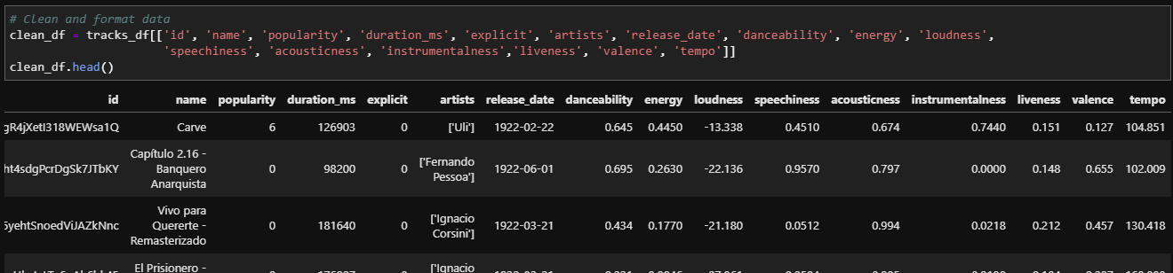
The Initial Cleaning

Slide 7
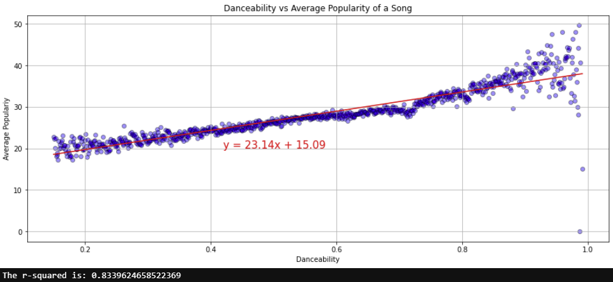
Danceability vs Average Popularity

Slide 8
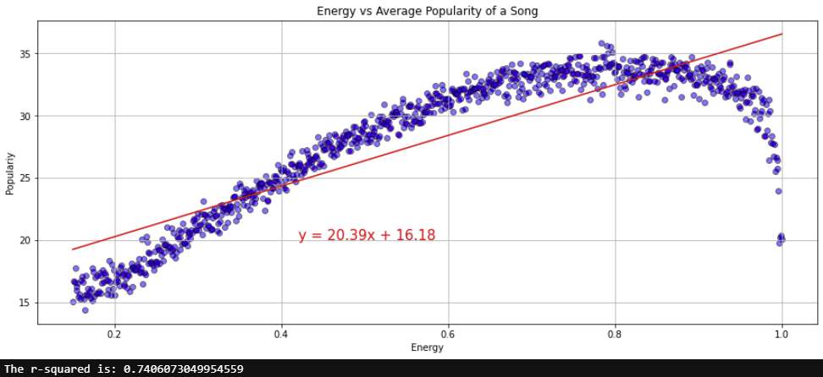
Energy vs Average Popularity

Slide 9
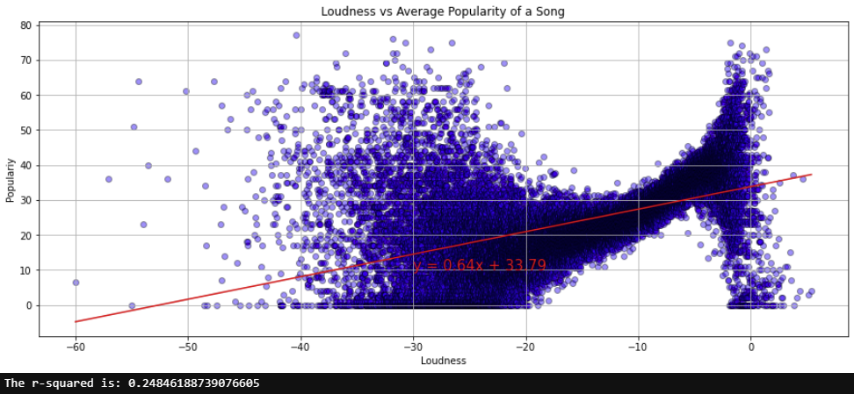
Loudness vs Average Popularity

Slide 10
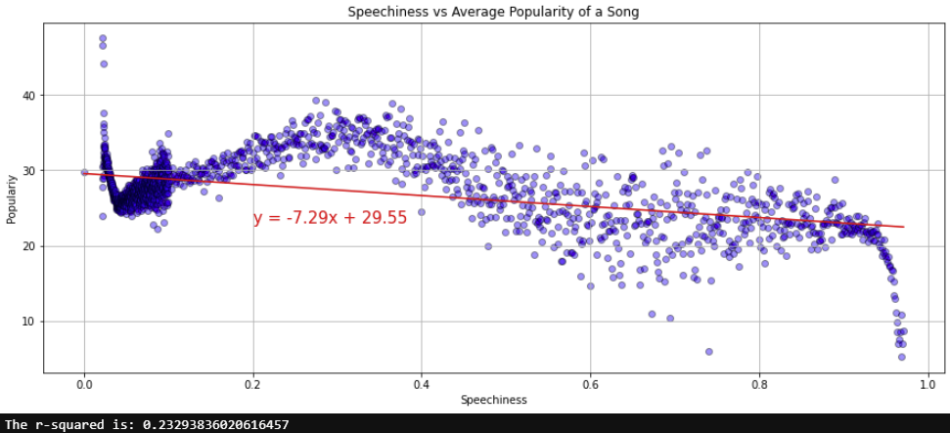
Speechiness vs Average Popularity

Slide 11
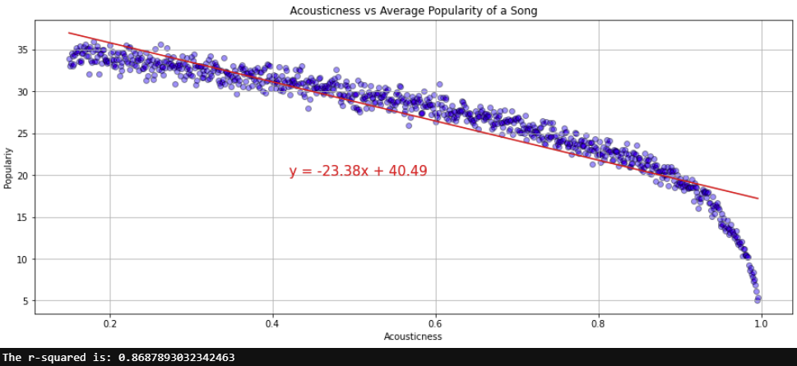
Acousticness vs Average Popularity

Slide 12
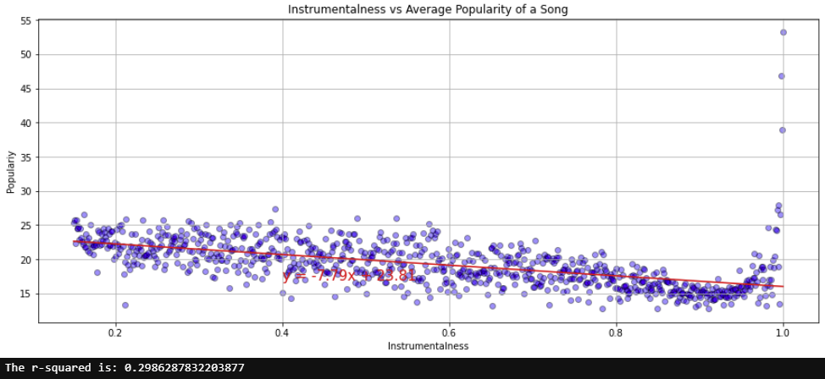
Instrumentalness vs Avg Popularity

Slide 13
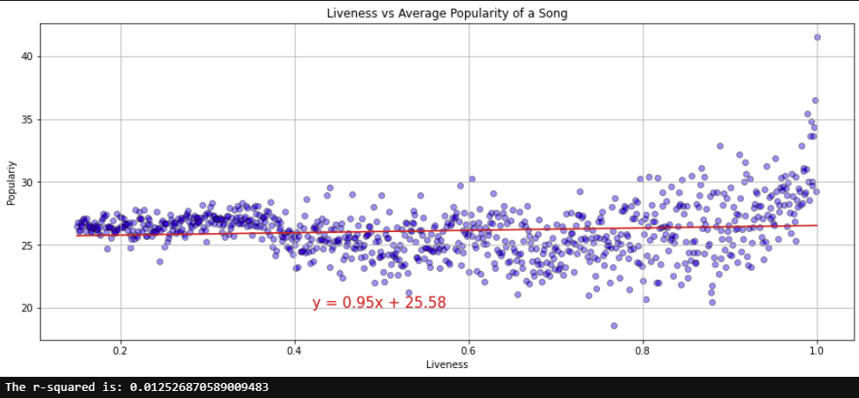
Liveness vs Avg Popularity

Slide 14
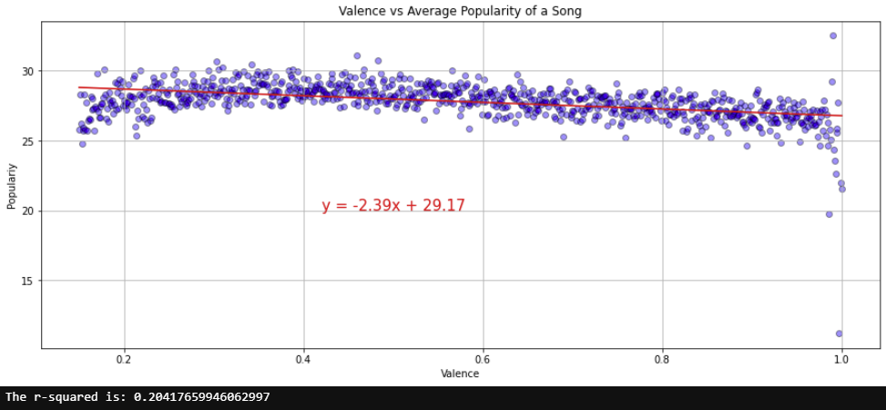
Valence vs Average Popularity

Slide 15
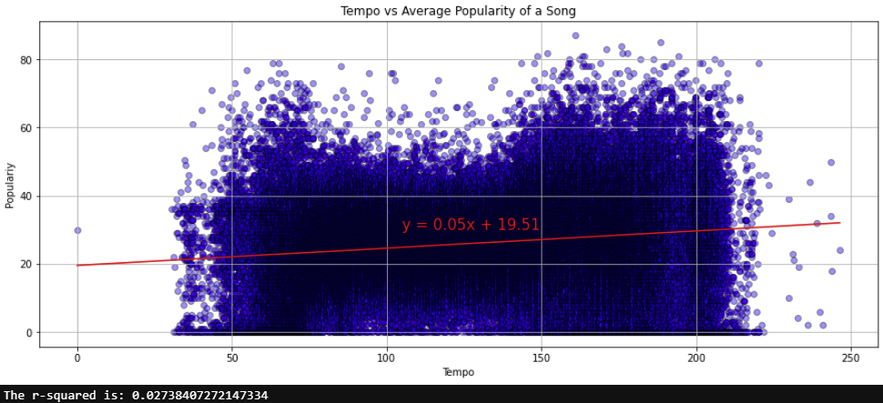
Tempo vs Average Popularity

Slide 16
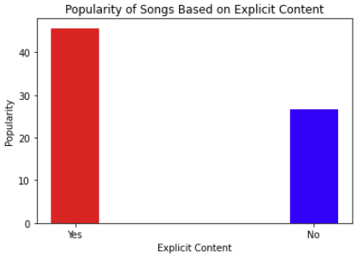
Average Popularity of Songs With vs Without Explicit Content

Slide 17
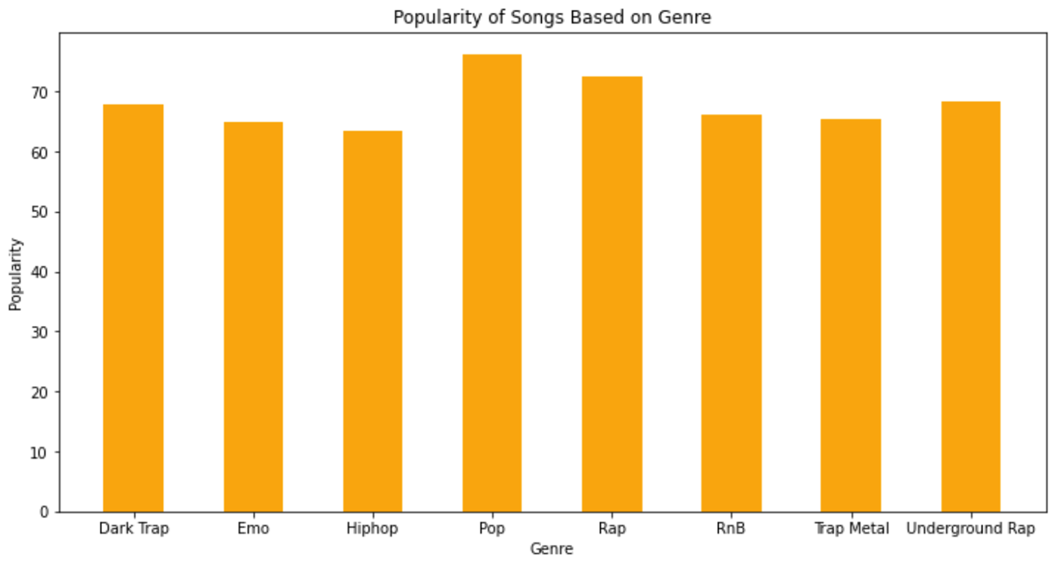
Average Popularity of Song Genres

Slide 18
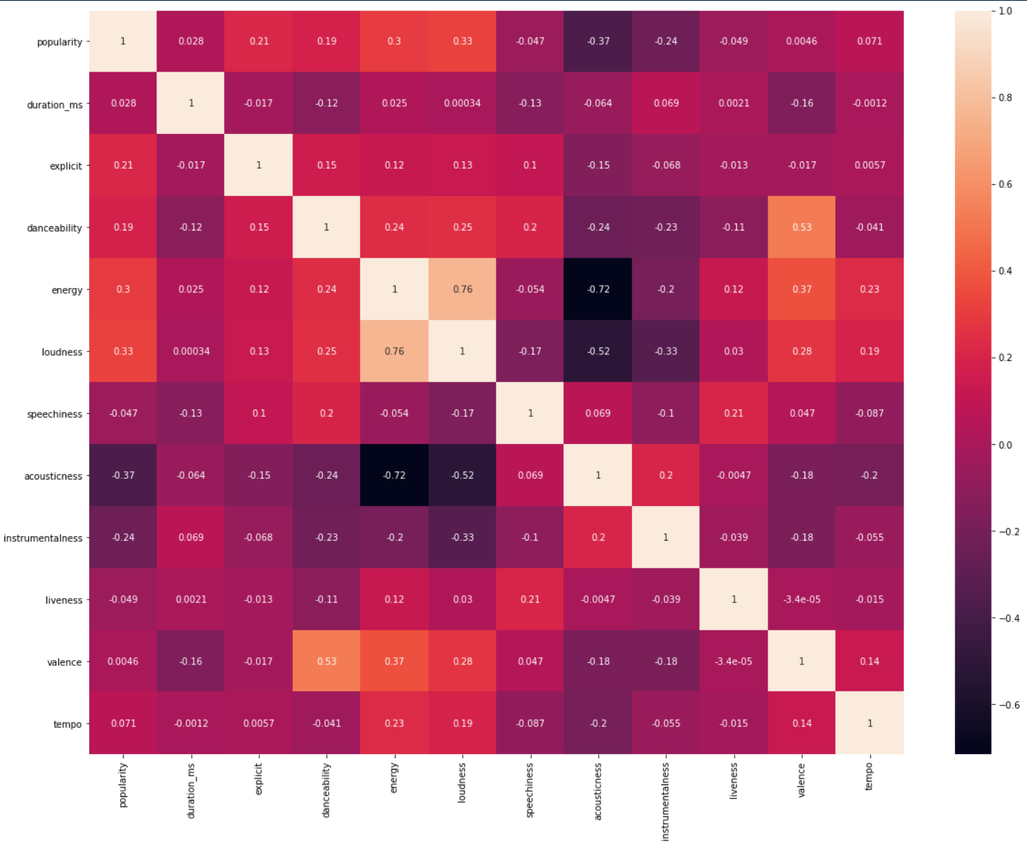
Correlations Among Audio Features

Slide 19
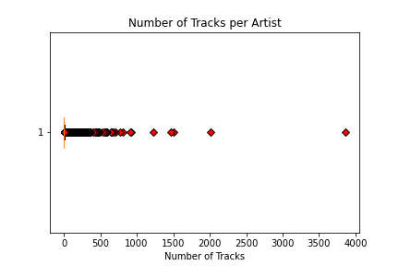
Does the number of tracks an artist has on Spotify relate to popularity?
108555 Artists
Mean = 5 songs/artist
Median = 1 song/artist
75th percentile = 3 songs/artist
Upper-bounds = 6 songs/artist

Slide 20
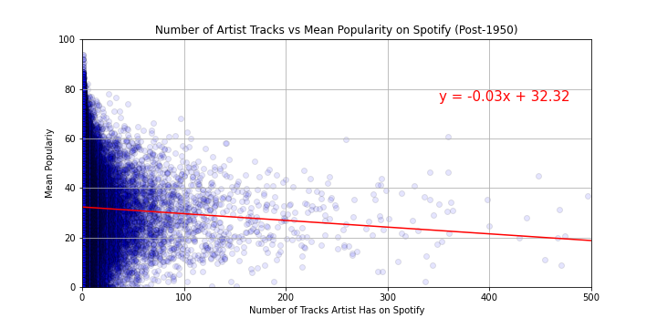
Mean Popularity by Artist Tracks

Slide 21
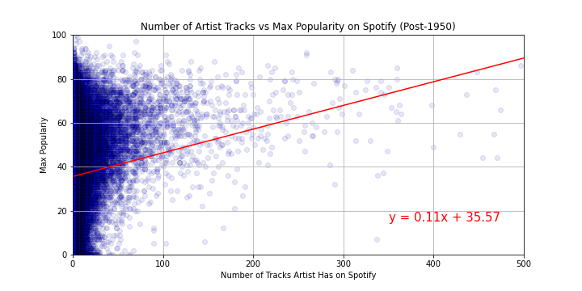
Maximum Popularity by Artist Tracks

Slide 22
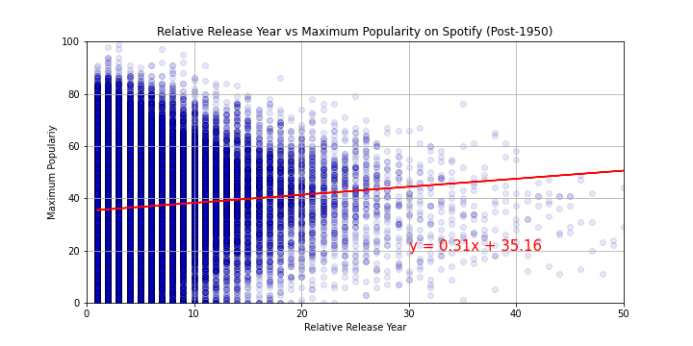
Do artists who have been on the charts longer, have higher popularity?

Slide 23
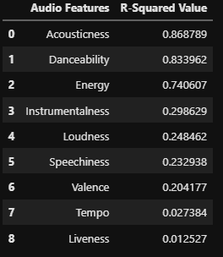
Conclusions and Implications
The strongest relationship exists between Acousticness and Danceability in relation to average popularity https://developer.spotify.com/documentation/web-api/reference/#endpoint-get-audio-features

Slide 24
Conclusions and Implications
Songs with explicit content, on average, have a higher average popularity rating than songs without explicit content.

Slide 25
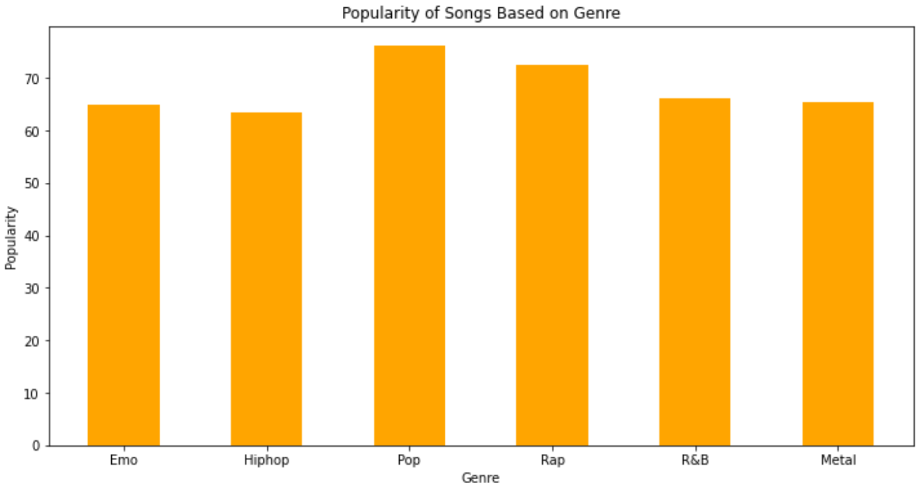
Conclusions and Implications
It is no surprise that the Pop genre has the highest average popularity, with Rap coming in a close second..m/documentation/web-api/reference/#endpoint-get-audio-features

Slide 26
Resources
https://www.kaggle.com/yamaerenay/spotify-dataset-19212020-160k-tracks
https://www.kaggle.com/mrmorj/dataset-of-songs-in-spotify
https://developer.spotify.com/documentation/web-api/reference/#endpoint-get-audio-features

